Slide 1
EU Funding Opportunities for Digital Resilience of MSMEs
Training proposal provided by IHF asbl

Slide 2
Index
Unit 1. Introduction to EU Budget
1.1 Setting the Scene: Understanding EU Financial Landscape
1.2 Inside the Budgeting Process: Long-term and Annual Budget
1.3 Empowering the Future: NextGenerationEU
1.4 Allocating Resources: Budget Allocation Strategies
1.5 Introducing the Path: Centralised vs. Decentralised Funding
Unit 2. A Deep Dive into EU Programmes
2.1 Focus on Direct vs. Shared Management Framework
2.2 Comprehensive Overview of EU Funding Programmes
2.3 Roots-like Structure of EU Funding Programmes: E+ as an Example
2.4 Examples of EU Programmes for Upskilling, Reskilling and Business Competitiveness
Unit 3. The Standard EU Project’s Lifecycle – Start & Apply
3.1 Macro-Initial Phase: From Project Idea to Proposal
3.2 Proposal Development Phase: Framework and Key Elements
3.3 Submission and Proposal Evaluation Process

Slide 3
Learning objectives
At the end of this module you will be able to…
EU BUDGET
Understand the concept landscape of reference for EU budgeting, evaluating trends up to 2027
Analyse the multiannual financial framework (MFF), NextGenerationEU and annual budgeting processes with related management frameworks, identifying their role in shaping EU funding policies
EU PROGRAMMES
Navigate the diverse landscape of EU funding programmes, understanding their roots-like structure
Evaluate specific EU programmes addressing upskilling, reskilling, and business competitiveness, with insights into their application for MSMEs
EU PROJECTS
Comprehend the EU project’s lifecycle, from the project’s idea to the evaluation process

Slide 4
Unit 1. Introduction to EU Budget
1.1 Setting the Stage: Understanding EU Financial Landscape (1)
EU BUDGET: a pivotal force, not as a replacement but as a complement to national budgets. It serves as a reservoir of financial and economic resources strategically deployed by EU institutions to sustain economies and societies, extending impact beyond national borders. This financial lifeline empowers EU countries to attain superior performances than they would achieve independently.
The essence of the EU budget lies in its multifaceted support system:
Long-term Development Goals: The EU budget channels resources towards fostering sustainable development, laying the groundwork for enduring societal and economic advancements
Savings of Public Funds: Acting as a (co)financer of expansive projects, the EU budget facilitates substantial savings in public funds, fostering responsible and impactful financial practices
Internationalisation of Best Practices: By nurturing an environment conducive to international collaboration, the EU budget promotes the exchange of best practices and case studies across national borders
Timely and Efficient Support: The EU budget positions itself as a timely and efficient support system, extending its reach to citizens, public administrations, and businesses when needed the most
1
2
3
4

Slide 5
Unit 1. Introduction to EU Budget
1.1 Setting the Stage: Understanding EU Financial Landscape (2)
EU budget represents a dynamic financial journey, strategically aligned with the EU’s long-term objectives. It operates within multi-annual structured cycles, aiming to ensure strategic financial management over set periods.
The multi-annual structured cycles are settled in seven-year intervals, with the current one that spans from 2021 to 2027.
This cyclical approach in the strategic planning of financial activities is reflected in the operation of the budget and fund management within specific intervals, which are also cyclical – from long-term budget to annual budget.
Periodically, the effective deployment of funds goes through the following steps that make up a management process:
PLANNING
APPROVAL
IMPLEMENTATION
EVALUATION
EU institutions collaboratively plan financial allocations through the launch of specific programmes.
The budget planned or requested by the various beneficiaries undergoes approval processes, ensuring alignment with EU objectives.
Funds are distributed and projects are implemented.
Results are continuously assessed to gauge the impact and effectiveness of financial allocations.

Slide 6
Unit 1. Introduction to EU Budget
1.2 Inside the Budgeting Process: Long-term and Annual Budget (1)
Building upon the understanding of the EU financial landscape and the introduction of related seven-year cyclicality, let’s delve inside the budgeting process, navigating it from the long-term to the annual implications.
Long-term Budget
Also recognised as Multiannual Financial Framework (MFF), this long-term budget spans seven years, establishing spending funds for EU categories and priorities like digitalisation or rural development.
Recall the seven-year cycles, MFF acts as a strategic blueprint, steering EU initiatives. The current 2021-2027 MFF aligns with EU priorities and long-term agenda, fostering coherence in programmes and projects.
MFF negotiation involves key EU institutions (Parliament, Council, and Commission) where the Commission plays a pivotal role in proposing funds allocation and spending ceilings, revenue streams, resource decision and legislation for related funding programmes.
Annual Budget
Complementing the MFF, the Annual Budget addresses specific yearly priorities through collaborative (re)negotiation among EU institutions.
Within a seven-year cycle, it represents the pivotal focus to align short-term goals with the broader MFF strategy. As a dynamic process, it allows agile responses, eventually adapting to emerging needs and opportunities within the single year – e.g., COVID, geopolitical shocks.
The Annual Budget undergoes a rigorous calendar-driven negotiation process, involving estimates (by July), proposals (by September), and positions (by October) from the Commission, Council, and Parliament, ensuring transparency and adaptability.
Within this holistic framework of the EU budgeting process, the MFF and Annual Budget work in tandem, effectively ensuring a balance between long-term vision and short-term goals, also allowing for agile responsiveness as needed.

Slide 7
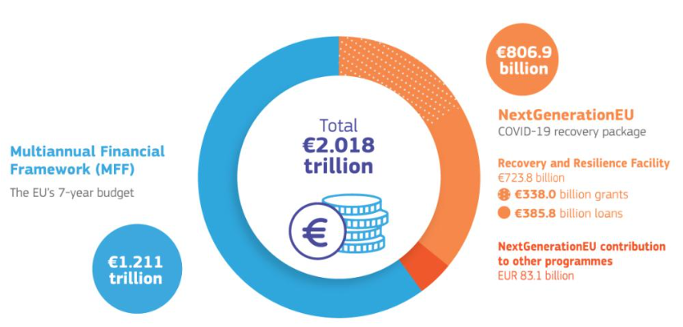
Unit 1. Introduction to EU Budget
1.2 Inside the Budgeting Process: Long-term and Annual Budget (2)
Focusing on the 2021-2027 cycle, the EU’s long-term budget, powered by the NextGenerationEU recovery instrument, reaches an unprecedented €2.018 trillion (as per current prices in November 2020).
Dual composition:
MFF for 2021-2027: €1.211 trillion
NextGenerationEU: €806.9 billion
Key highlights:
Over 50% of the total aims to advance the EU through research, innovation, fair climate and digital transitions, as well as preparedness, recovery, and resilience, marking a significant focus in modernisation
31.9% is allocated to address new and reinforced priorities, underscoring a dynamic approach to emerging challenges
30% is dedicated to address the challenges of climate change, with a focus on biodiversity protection and gender-related issues
10% of the spending for 2026 and 2027 is committed to biodiversity
20% of NextGenerationEU funding is directed toward bolstering the digital transformation
2021-2027: A modernised EU long-term budget, powered by the NextGenerationEU
Source: European Commission, The 2021-2027 EU budget – What’s new?

Slide 8
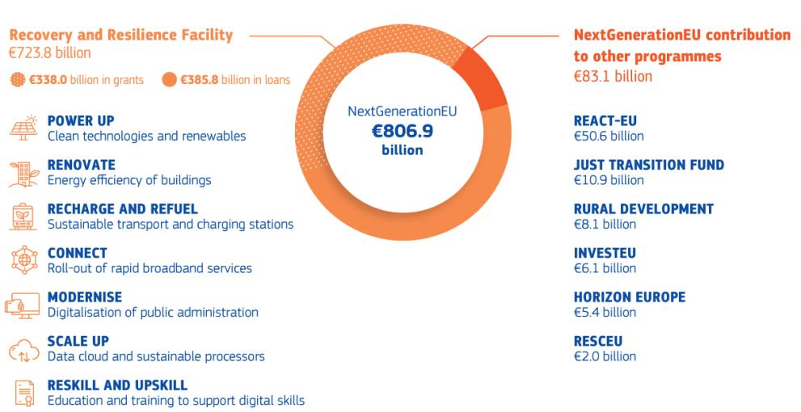
Unit 1. Introduction to EU Budget
1.3 Empowering the Future: NextGenerationEU
…but what is the NextGenerationEU?
NextGenerationEU is a recovery instrument complementing the MFF introduced in 2020 in response of the socio-economic repercussions of the pandemic. It aims to steer Europe towards research, innovation, sustainability, digital transitions, and resilience at large.
NextGenerationEU foresees a financial injection of EUR 806.9 billion, of which EUR 723.8 billion is earmarked for the Recovery and Resilience Facility (RRF), plus a contribution of EUR 83.1 billion to existing programmes such as REACT-EU, HORIZON EU, etc.
The RRF provides substantial support for public investments, with a focus on green and digital projects. Funded by NextGenerationEU, these resources, totalling €338 billion in grants and €385.8 billion in loans, have been channelling into various programmes and among EU countries as beneficiaries, i.e. the National Recovery and Resilience Plan (NRRP).
The allocation of funds follows criteria like GDP per capita, unemployment rates, population size, and the pandemic’s impact.
NextGenerationEU: more than €800 billion for Europe’s recovery
Source: European Commission, The 2021-2027 EU budget – What’s new?

Slide 9
Unit 1. Introduction to EU Budget
1.4 Allocating Resources: Budget Allocation Strategies (1)
Who benefits from the EU budget?
Efficiently organising funding, the EU budget strategically divides resources into spending categories (headings – see next slide for further details) and programmes, ensuring effective support for beneficiaries across various EU policy areas. This approach facilitates a cross-cutting impact, aligning with the overarching goals of the long-term budget.
Integration with NextGenerationEU:
While NextGenerationEU operates as a distinct instrument, its financial streams seamlessly integrate with programmes embedded in the long-term budget. This synergy ensures that the impact of NextGenerationEU is maximised across diverse policy domains.
Dual Funding for Key Headings:
To amplify its influence, several headings receive funding from both the MFF and NextGenerationEU. This collaborative approach enhances the budget’s capacity to address multifaceted challenges and bolster transformative initiatives.

Slide 10
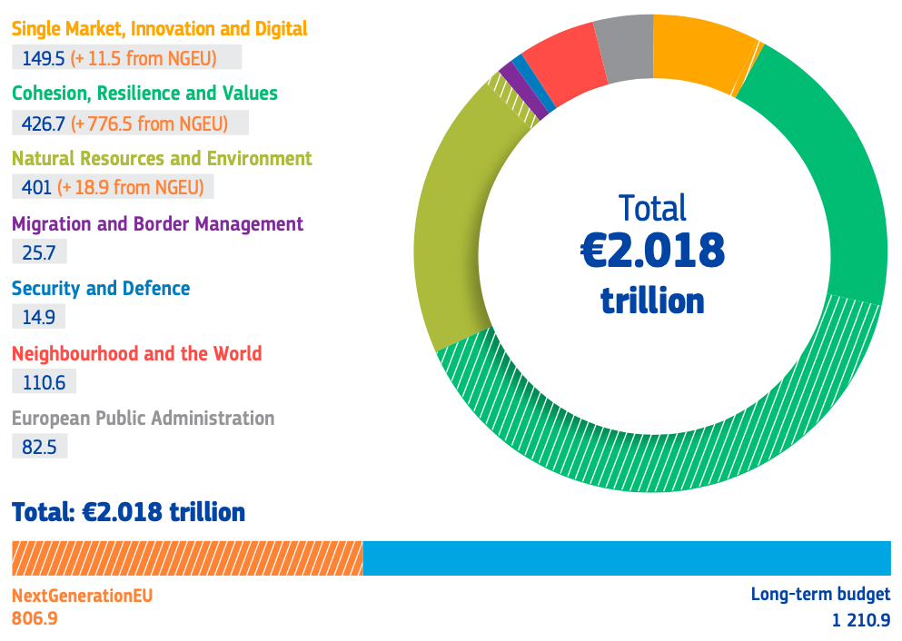
Unit 1. Introduction to EU Budget
1.4 Allocating Resources: Budget Allocation Strategies (2)
Heading 1: Single Market, Innovation and Digital
Research and Innovation
EU strategic investments
Single Market
Space
Heading 2: Cohesion, Resilience and Values
Regional Development & Cohesions
Recovery and Resilience
Investing in People, Social Cohesion and Values
Heading 3: Natural Resources and Environment
Agriculture & Maritime Policy
Environment & Climate Action
Heading 4: Migration & Border Management
Migration
Border Management
Heading 5: Security & Defence
Security
Defence
Heading 6: Neighbourhood & The World
External Action
Pre-Accession Assistance
Heading 7: European Public Administration
Allocations per heading for 2021 to 2027 – in billion
Source: European Commission, The EU’s 2021-2027 long-term budget and NextGenerationEU – Facts and figures

Slide 11
Unit 1. Introduction to EU Budget
1.4 Allocating Resources: Budget Allocation Strategies (3)
Allocations per policy and programme – with a focus on MFF
Breaking down the 2021-2027 MFF reveals targeted allocations that drive impactful policies and programmes.
A substantial 31.9% is earmarked for critical areas such as research, education, and border protection, fostering a holistic approach to EU priorities. When integrating NextGenerationEU funding, this share surges beyond 50% of the total, emphasising the collective commitment to fortify key sectors for sustainable growth and resilience.
Additionally, economic, social, and territorial cohesion secures a 30.5% share, while the common agricultural policy commands 30.9%. Notably, both policies undergo significant modernisation, aligning with the overarching goal of supporting green and digital transitions.
To the right, a detailed table presents an overview of MFF allocations per policy and programme, offering transparency and insight into the strategic distribution of resources.
Long-term budget allocation (2021-2027) | Billions
Cohesion Policy | 372.6
European Regional Development Fund (ERDF) | 226
Cohesion Fund (CF) | 48
European Social Fund+ (ESF+) | 98.5
Common Agricultural Policy (CAP) | 378.5
European Agriculture Guarantee Fund (EAGF) | 291
European Agricultural Fund for Rural Development (EFRD) | 87.4
New and reinforced priorities | 377.3
Horizon Europe | 86.1
Neighbourhood, development and international Cooperation Instruments | 79.5
Connecting Europe Facility | 20.7
InvestEU | 3
European Space Programme | 14.9
Digital Europe Programme | 7.6
Single Market Programme | 4.2
Justice, Rights & Values | 0.9
EU4Health | 2.4
RescEU | 1.3
Creative Europe | 1.8
Erasmus+ | 24.6
Humanitarian Aid | 11.6
Life (Climate and Environmental Action) | 5.4
Just Transition Fund | 8.4
Other | 105

Slide 12
Unit 1. Introduction to EU Budget
1.5 Introducing the Path: Centralised vs. Decentralised Funding
Centralised Funding
The centralised funding involves the direct management and execution of funds and programmes by EU institutions. Here, the European Commission takes a lead role in administering and managing programmes and initiatives, ensuring uniformity and cohesion in implementation
Examples:
Horizon Europe: A flagship EU programme for research and innovation directly managed by the EU Commission
Erasmus+: Centralised funding for education, training, youth, and sport programmes under the EU Commission’s oversight
Decentralised Funding
In contrast with the centralised funding, the decentralised one empowers Member States (and Regions) to manage EU funds in a shared management framework. They take the lead in the design, execution, and oversight of programmes, aligning EU objectives and goals with regional needs and priorities.
Examples:
Common Agricultural Policy (CAP): Member States design agricultural programmes tailored to their specific needs
European Regional Development Fund (ERDF): Decentralised funding addressing regional needs and disparities and promote local development initiatives
Strategic Collaboration: Both routes come together to accomplish general EU objectives. Centralised financing simplifies programmes throughout the EU, whereas decentralised funding encourages customised initiatives that take into account the uniqueness and diversity of local needs.

Slide 13
Unit 2. A Deep Dive into EU Programmes
2.1 Focus on Direct vs. Shared Management Framework (1)
Within the direct management framework, let’s explore the leading role of the European Commission. It assumes a pivotal position, directly being responsible and overseeing every facet of a programme’s implementation:
Launching Calls for Proposals: Initiating the process by inviting project proposals
Evaluating Submitted Proposals: Rigorous assessment to ensure alignment with objectives
Signing Grant Agreements: Formalizing commitments with successful project proponents
Monitoring Project Implementation: Ongoing oversight to guarantee adherence to set guidelines
Assessing the Results: Evaluation of project outcomes against predefined criteria
Making Payments: Facilitating financial disbursements as stipulated
These comprehensive tasks unfold within the Commission's departments, spanning its headquarters, EU delegations, or through designated EU executive agencies. Notably, centralised programs executed through direct management constitute approximately 20% of the EU budget for 2021-2027. This centralized approach ensures a cohesive and streamlined implementation process, driven solely by EU entities without the involvement of external third parties.

Slide 14
Unit 2. A Deep Dive into EU Programmes
2.1 Focus on Direct vs. Shared Management Framework (2)
Beside the direct management framework, let’s focus on the shared management framework, where EU funds are jointly administrated with the Member States and Regions. This collaborative model involves both the European Commission and national authorities within Member States, including ministries and public institutions, jointly overseeing specific programmes. Approximately 70% of EU programmes operate under this shared management structure.
Within shared management, Member States’ administrations at national, regional, and local levels play a key role in selecting projects for financing and assume day-to-day management responsibilities. Through a synergistic partnership with Member States, the EU Commission ensures the successful completion of projects and the effective utilisation of funds.
The national website portals and programme websites provide real-time information on upcoming funding opportunities. This includes details such as the regions covered by funding calls, eligibility criteria, funding amounts, programme and EU policy objectives, and timelines.
Key EU funds managed under the shared framework include:
European Regional Development Fund (ERDF)
European Social Fund Plus (ESF+)
Cohesion Fund (CF)
Just Transition Fund (JTF)
European Maritime, Fisheries and Aquaculture Fund (EMFAF)
Asylum, Migration and Integration Fund (AMIF)
Internal Security Fund (ISF)
Instrument for Financial Support for Border Management and Visa Policy (BMVI)

Slide 15
Unit 2. A Deep Dive into EU Programmes
2.2 Comprehensive Overview of EU Funding Programmes (1)
Recalling the EU programmes highlighted in the resource allocation discussion (refer to section 1.4 (3) – slide no. 11), let’s now explore their distribution across various cross-cutting priority areas. Each programme is dedicated to supporting distinct policy areas, as illustrated below:
Cohesion policy
Common agricultural policy
Just Transition Fund
Horizon Europe
Recovery and Resilience Facility
LIFE programme Connecting Europe Facility
European Social Fund+
Erasmus+
European Solidarity Corps
Horizon Europe
Creative Europe
GREEN
TRANSITION
HUMAN CAPITAL
FOSTERING INVESTMENTS
InvestEU
Cohesion policy
European Fund for Sustainable Development+
Single Market programme
Recovery and Resilience Facility
DIGITAL TRANSITION
Horizon Europe
Digital Europe programme
Connecting Europe Facility
Cohesion policy
Recovery and Resilience Facility
OPEN STRATEGIC AUTONOMY
European Defence Fund
European space programme Military mobility
EU4Health
Horizon Europe
Common foreign and security policy
Source: European Commission, The EU’s 2021-2027 long-term budget and NextGenerationEU – Facts and figures

Slide 16
Unit 2. A Deep Dive into EU Programmes
2.2 Comprehensive Overview of EU Funding Programmes (2)
Access EU funding & tenders’ opportunities and available EU programmes through the SEDIA Portal – free consultation
Asylum, Migration and Integration Fund (AMIF) | Border Management and Visa Policy Instruments (BMVI) | Citizens, Equality, Rights and Values Programme (CERV) | Connecting Europe Facility (CEF) | Creative Europe Programme (CREA) | Customs Control Equipment Instrument (CCEI)
Customs Programme (CUST) | Digital Europe Programme (DIGITAL) | Erasmus+ (ERASMUS+) | EU External Action (RELEX) | EU4Health Programme (EU4H) | Euratom Research and Training Programme (EURATOM)
Europe Direct (ED) | European Defence Fund (EDF) | European Maritime, Fisheries and Aquaculture Fund (EMFAF) | European Parliament (EP) | European Social Fund + (ESF+) | European Solidarity Corps (ESC)
Fiscalis Programme (FISC) | Horizon Europe (HORIZON) | Information Measures for the EU Cohesion policy (IMREG) | Innovation Fund (INNOVFUND) | Internal Security Fund (ISF) | Interregional Innovation Investments Instrument (I3)
Just Transition Mechanism (JTM) | Justice Programme (JUST) | Neighborhood development and international cooperation (NDICI) | Pilot Projects and Preparation Actions (PPPA) | Programme for the Environment and Climate Action (LIFE) | Programme for the protection of the Euro against Counterfeiting (PERICLES IV)
Promotion of Agricultural Products (AGRIP) | Research Fund for Coal and Steel (RFCS) | Single Market Programme (SMP) | Social Prerogative and Specific Competencies Lines (SOCPL) | Technical Support Instrument (TSI) | Union Anti-fraud Programme (EUAF)
Union Civil Protection Mechanisms (UCPM) | Union Renewable Energy Financing Mechanism (RENEWFM) | …and many more

Slide 17
Unit 2. A Deep Dive into EU Programmes
2.3 Roots-like Structure of EU Funding Programmes: E+ as an Example
ERASMUS+
Key Action 2, Cooperation among organizations and institutions
Partnership for Cooperation
Partnership for innovation
Key Action 1, Mobility of individuals
Mobility of learners and staff
Youth Participation activities
Mobility for Sport coaches
Discover EU
Language learning opportunities
Virtual exchange in HE and Youth
Cooperation partnership
Small scale partnership
Partnership for excellence
European Universities
Centre for Vocational Excellence
E+ teachers academies
Erasmus Mundus Action
Alliances for innovation
Forward-looking projects
Capacity Building (CB) projects
CB in HE
CB in VET
CB in Youth
CB in Sport
Not for profit Sport events
Key Action 3, Support to policy development and cooperation
Jean Monnet Actions
JM in HE
JM in other fields
JM networks in HE
Support to designated institutions

Slide 18
Unit 2. A Deep Dive into EU Programmes
2.4 EU Programmes for Upskilling, Reskilling and Business Competitiveness (1)
Here are some examples of key EU programmes dedicated, among other things, to skills development and promoting the competitiveness of micro, small, and medium-sized enterprises (MSMEs). These enterprises are encouraged to explore these valuable opportunities to strengthen their digital resilience and remain competitive.
Erasmus+
Erasmus+ stands as a flagship EU programme, promoting skills development through international collaboration, providing opportunities for work placements, vocational training, and strategic partnerships. Its initiatives cover a broad spectrum, from vocational education and training to adult learning, fostering a skilled workforce adaptable to digital advancements.
Benefits for MSMEs: Gain access to a diverse talent pool, explore international partnerships, and leverage insights for continuous skill enhancement, fostering adaptability in the face of technological changes.
European Social Fund Plus (ESF+)
The European Social Fund Plus focuses on social inclusion and employment. In the realm of skills development, ESF+ supports projects aimed at enhancing workforce skills, promoting lifelong learning, and ensuring equal access to employment opportunities. Its initiatives address the entire skills spectrum, from basic education to advanced professional development.
Benefits for MSMEs: Tap into funding opportunities for comprehensive training programmes, skill-building initiatives, and projects promoting social inclusion, contributing to a skilled and inclusive workforce.

Slide 19
Unit 2. A Deep Dive into EU Programmes
2.4 EU Programmes for Upskilling, Reskilling and Business Competitiveness (2)
Horizon Europe – Cluster 4: Digital, Industry, and Space
Cluster 4 of Horizon Europe focuses on digital transformation and innovation. Within this cluster, EU programmes support projects that advance digital skills, foster innovation in industry, and enhance competitiveness in the digital era. From research and development initiatives to collaborative projects, it offers a comprehensive approach to strengthening business competitiveness.
Benefits for MSMEs: Seize opportunities for collaborative research, engage in innovative projects, and gain access to cutting-edge technologies, positioning MSMEs at the forefront of digital competitiveness.
InvestEU
InvestEU, a successor to the COSME programme for MSMEs, is a EU initiative designed to boost investment, innovation, and job creation in Europe. It operates through loans, guarantees, and equity, aiming to mobilise private investment to address market failures and encourage sustainable growth. InvestEU covers a range of sectors, including innovation, digitalisation, and environmental sustainability, fostering a competitive and resilient business environment.
Benefits for MSMEs: Engage in innovative projects and initiatives with access to diverse financial instruments. InvestEU supports MSMEs in gaining financial backing for projects that contribute to their competitiveness, digitalisation, innovation, and sustainability. By participating in InvestEU, businesses can tap into a network of resources and opportunities to strengthen their market position.

Slide 20
Unit 3. The Standard EU Project’s Lifecycle – Start & Apply
3.1 Macro-Initial Phase: From Project Idea to Proposal (1)
The journey of an EU project begins with the conception of an idea. The initial step involves conceptualising a project that aligns with EU priorities and objectives. This idea is then shaped into a comprehensive formal project proposal – to be submitted. The macro-initial phase of moving from an idea to a proposal consist of various key steps:
Project Conceptualisation:
Identify a concept for a project that aligns with EU priorities
Define the overarching objectives, goals and outcomes of the proposed idea of project through a concept note
In-Depth Analysis:
Assess the feasibility of the project, considering resources, timelines, and any challenges
Conduct a preliminary review of the project’s alignment with EU objectives and goals
Partner(s) and Stakeholder(s) Engagement:
Identify and engage relevant stakeholders, including potential partners, targets, and experts
Gather input and support for the project idea from key stakeholders
Alignment with EU Guidelines:
Ensure that the concept note aligns with the guidelines and priorities of the specific and targeted EU funding programme
Address any specific requirements outlined in the funding call of reference
Detailed Project Planning:
Develop a detailed project plan outlining specific activities, milestones, deliverables and timelines
Formulate a budget estimate based on the planned project plan

Slide 21
Unit 3. The Standard EU Project’s Lifecycle – Start & Apply
3.1 Macro-Initial Phase: From Project Idea to Proposal (2)
To transition from the macro-initial phase to the proposal writing (and then to its submission), it is essential to deal with the key documents that guide the proposal process. These include:
EU Regulation: The official regulation, published on the Official Journey of the European Union, that establish the specific programme in its elements such as budget, % funding, timeline, funded actions, etc.
Work Programme: A comprehensive document outlining the strategic objectives, priorities, roadmap for deadlines, budget breakdown and specific areas of interest for funding within a certain period. It is published on the programme’s website
Programme Guide: A detailed manual providing in-depth insights into the overall structure, rules, objectives, priorities and specific requirements of the funding programme. It also includes the eligibility and award criteria for a proposal
Call for Proposals: Also published on the Official Journey of the European Union and notified through the news section of the programme website, it opens the period for submitting a proposal, representing the official call that specifies the procedural details and the deadlines for each action
Form: The official template through which applicants submit their project proposals, capturing essential details outlined in the Call for Proposals
Applicants must thoroughly analyse these documents to align the project idea with the programme’s characteristics. Key aspects to consider include:
Strategic Alignment
Thematic Relevance
Compliance
Form Completion

Slide 22
Unit 3. The Standard EU Project’s Lifecycle – Start & Apply
3.2 Proposal Development Phase: Framework and Key Elements (1)
When we introduce the form completion (see previous slide – no. 21), we have already started talking about the phase following the initial one, i.e. the proposal writing or development phase.
Adhering to the “WHY, WHAT, WHO, WHEN, HOW” framework ensures a systematic and comprehensive approach to proposal development. Here is a focus on the key elements of the proposal development phase:
Objectives – WHY:
General Objectives: Long-term aims producing benefits beyond the project duration, contributing, improving, strengthening, facilitating, and implementing
Specific Objectives: Attainable during the project’s lifetime, such as testing a concept or developing new knowledge
Tips:
Connect objectives to relevant European policies, such as the 2030 European Digital Decade
Showcase how the proposal addresses a pertinent problem
Measure potential impact / improvement, linking it to EU strategic objectives and specific programme’s priorities
Define mechanisms and actions for results sharing and promotion, uptake measures, and validation by end users
Ensure project sustainability: financial, political-institutional, environmental

Slide 23
Unit 3. The Standard EU Project’s Lifecycle – Start & Apply
3.2 Proposal Development Phase: Framework and Key Elements (2)
Results – WHAT:
Tangible Results (Deliverables): Concrete outcomes like platform, app, training curricula, publications, reports, etc.
Intangible Results: Includes new skills and knowledge, proven added value, etc.
Responsibilities – WHO:
Project Partners Agreement: Clearly defined roles and responsibilities for each partner, linking them with their expertise
External Stakeholder Involvement: Includes engaging and involving stakeholders, including for example an External Review Evaluation Committee, Associated Partners, etc.
Planning and Execution – WHEN & HOW:
Action Plan: Develop a comprehensive plan outlining the tasks, phases and timelines – also through project management tools such as a Gantt chart
Budget Allocation: Allocate the budget effectively, ensuring resources are distributed based on project needs and distribution of partners’ roles and responsibilities

Slide 24
Unit 3. The Standard EU Project’s Lifecycle – Start & Apply
3.3 Submission and Proposal Evaluation Process
After comprehensive development, the proposal is formally submitted through the designated platform (formal submission), signifying the conclusion of the idea-to-proposal process. The completed form is submitted through the specified platform, which varies according to the specific programme requirements.
At the same time, a new process begins: the proposal evaluation process.
Project Evaluation: The submitted proposal undergoes evaluation by designated entities and evaluators. Evaluation criteria include criteria such as clear objectives, tangible and intangible results, stakeholder responsibilities, and strategic alignment.
→ If Approved: The project proceeds to compliance and execution, with contract negotiations following feedback from evaluators. The project starts with a kick-off and concludes, after its implementation, with a final report on project results.
If Not Approved: A revision strategy is initiated, involving a detailed analysis of received feedback and necessary adaptations for improvement. The review process comprises two key phases:
Revision and Feedback: The revision phase focuses on improving the strengths of the proposal and correcting weaknesses identified through the evaluator's feedback, ensuring a stronger presentation in any subsequent evaluations
Continuous Improvement: This critical phase emphasises adaptability and commitment to the success of the project; each iteration reinforces the quality of the proposal and alignment with the evaluation criteria for resubmission

Slide 25
Summing up
EU BUDGET
Unit 1 explores the journey through the intricacies of the EU budget, a dynamic financial force strategically aligned with long-term objectives. Navigate the seven-year Multiannual Financial Framework (MFF) and the agile Annual Budget, witnessing the modernised 2021-2027 cycle powered by the NextGenerationEU recovery instrument. Delve into the €2.018 trillion allocation, emphasising digital and green transitions. Witness the EU budget’s impact on research, innovation, and resilience, fostering a cohesive, responsive, and forward-looking financial ecosystem.
EU PROGRAMMES
Unit 2 navigates the landscape of EU programmes, distinguishing between centralised and decentralised funding. Uncover the roots-like structure of funding programmes and explore their distribution across diverse policy areas. Witness the pivotal role of programs like Erasmus+, European Social Fund+, Horizon Europe, and InvestEU in upskilling, reskilling, and enhancing business competitiveness. Leverage the SEDIA portal for free consultations, empowering your journey to access EU funding opportunities.
EU PROJECT’S LIFECYCLE
Unit 3 embarks on the standard EU project lifecycle, from idea to proposal, submission, and evaluation. Master the macro-initial phase, meticulously shaping project concepts aligned with EU priorities. Dive into the proposal development phase, employing the “WHY, WHAT, WHO, WHEN, HOW” framework for clear objectives, tangible results, and strategic planning. Conclude with the submission and evaluation process, unveiling the pathway to project approval or strategic revision, ensuring continuous improvement for resilience in the competitive EU funding landscape.

Slide 26
Thank you!
Keep learning at www.digital-dream-lab.eu

